Slide 1
Presented by
Engr. Md. Abdur Rashid, PhD Fellow
Director (Admn & finance)
NAPD
https://www.researchgate.net/profile/Md_Abdur_Rashid
Welcome at Computer Basic Class
rashid.eee.cse@gmail.com

Slide 2
Session Target
Data and Information
Idea about Computer
Binary Number system
Computer parts
About memory
Programming idea
Future computer
rashid.eee.cse@gmail.com

Slide 3
Data and Information
Data vs. Information
  Data
    A “given,” or fact; a number, a statement, or a picture
    Represents something in the real world
    The raw materials in the production of information
  Information
    Data that have meaning within a context
    Data in relationships
    Data after manipulation
rashid.eee.cse@gmail.com

Slide 4
Overview of Computer
The word ‘Computer’ comes from the word ‘Compute’ – meaning calculate.
More accurately, Computer is a device that operates upon information or Data.
A computer can store, process and retrieve data as and when desired – naming it ‘data processor’.
rashid.eee.cse@gmail.com

Slide 5
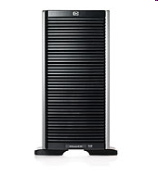
HP ProLiant ML: expandable tower servers for small to medium-sized businesses
HP ProLiant ML350 G5 Storage Server
rashid.eee.cse@gmail.com

Slide 6
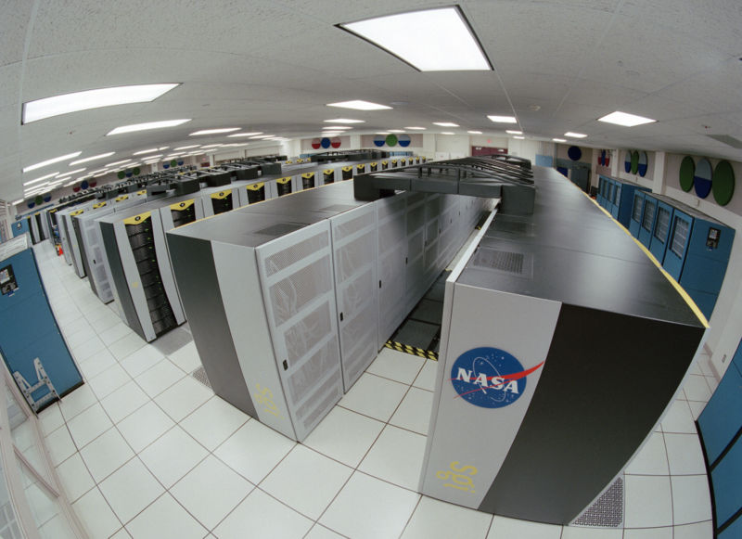
800px-Columbia Supercomputer – NASA Advanced Supercomputing Facility

Slide 7
Characteristics of Computers
Speed
Accuracy (GIGO)
Diligence
Versatility
Power of Remembering
No I.Q
No Feelings
rashid.eee.cse@gmail.com

Slide 8
Computer run by
Binary Number System
Decimal | Binary
0 | 00000000
1 | 00000001
2 | 00000010
3 | 00000011
4 | 00000100
5 | 00000101
6 | 00000110
7 | 00000111
8 | 00001000
9 | 00001001
10 | 00001010
rashid.eee.cse@gmail.com

Slide 9
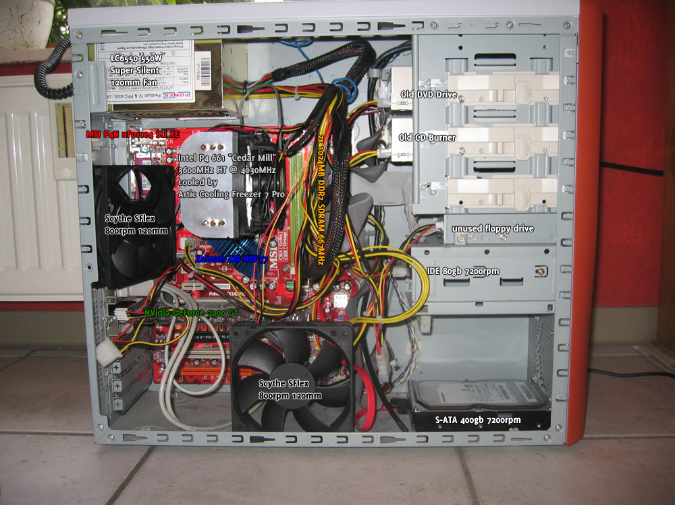
Casing

Slide 10
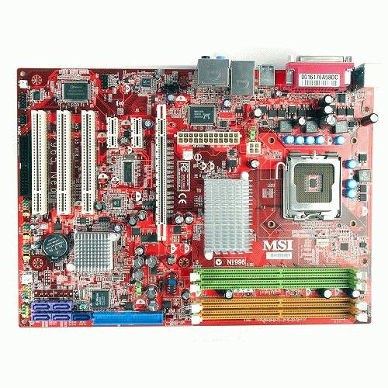
Motherboard

Slide 11
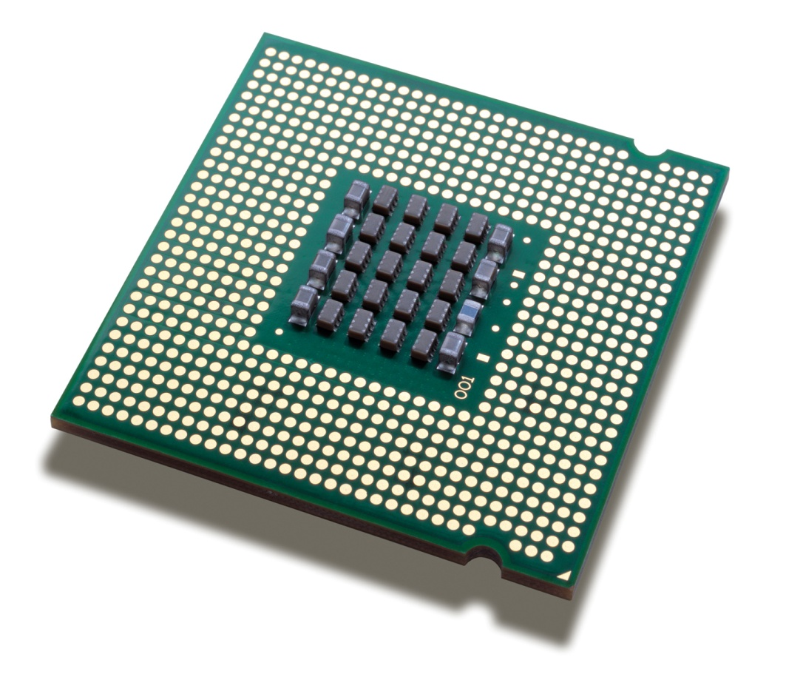

Processor (Central Processing Unit, CPU)
Intel Processor series:
4bit (start)
4040
Speed- 740 Khz
Designed for calculator
.
.
.
64 bit (Latest):
2nd Generation Intel® Core™ i7 Extreme Processor
2nd Generation Intel® Core™ i5
2nd Generation Intel® Core™ i3
Speed- Maxm 3.5 Ghz support
6th Gnrn Core i9
Ref: www.intel.com
rashid.eee.cse@gmail.com

Slide 12
Memory Difference
RAM (Random Access Memory) | ROM
Data is both written to and read from this memory. RAM is volatile – so it needs constant power supply. When the computer is turned off, everything in RAM disappears. RAM affects the speed and power of a computer. Generally the more RAM a computer has, the more it can do and faster it can perform certain tasks. | It is Permanent Memory User can not remove data Helps to start the computer
rashid.eee.cse@gmail.com

Slide 13

RAM
Latest DDR3
Double speed to DDR2
Low voltage 1.5 volt only
rashid.eee.cse@gmail.com

Slide 14
How memory can be measured?
Bit=a 1 or 0
Byte=8 bits
Kilobyte=1024 bytes
Megabyte=1024 kilobytes
Gigabyte=1024 megabytes
Terabyte=1024 gigabytes
Petabyte=1024 Terabyte
Exabyte=1024 Petabyte
Zettabyte = 1024 Exabyte
Yottabyte=1024 Zettabyte
rashid.eee.cse@gmail.com

Slide 15
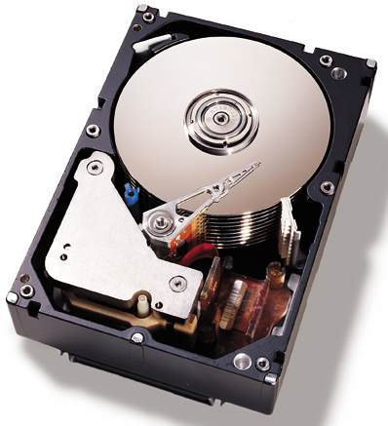
Top view of a 36 GB, 10,000 RPM, IBM SCSI server hard disk
rashid.eee.cse@gmail.com

Slide 16
Programming Languages
Instructions written by a programmer to solve a problem is called programme
Example
  C
  C++
  Java
  C#
  Visual Basic
  SQL/PLSQL
  Python
  PHP
rashid.eee.cse@gmail.com

Slide 17
Program for calculate sum using c++
//1+2+3+.........+n//
#include<iostream.h>
#include<conio.h>
void main()
{
clrscr();
long double sum=0,n,i;
cout<<"enter n:";
cin>>n;
for(i=1;i<=n;i++)
{
sum+=i;
}
cout<<sum;
getch();
}
rashid.eee.cse@gmail.com

Slide 18

rashid.eee.cse@gmail.com

Slide 19
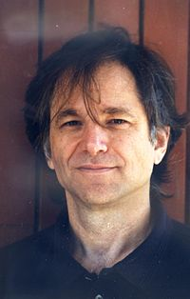
Leonard Adleman, the inventor of DNA computing
Leonard Adleman of the University of Southern California initially developed this field in 1994
rashid.eee.cse@gmail.com

Slide 20
IBM 5 in 5 Technology 2011:
IBM’s “A Smarter Planet”
IBM has released its latest annual “IBM 5 in 5" list of five innovations that have the potential to change the way people work, live and interact during the next five years.
Nanotechnology is the study of manipulating matter on an atomic and molecular scale. Generally, nanotechnology deals with developing materials, devices, or other structures possessing at least one dimension sized from 1 to 100 nanometres
One nanometer (nm) is one billionth, or 10⁻⁹, of a meter
Ref:
http://asmarterplanet.com/
http://www.digitaltrends.com/mobile/ibm-forecasts-biometric-passwords-mind-reading-tech-for-2016/
rashid.eee.cse@gmail.com

Slide 21
DNA computing Definition
DNA computing is an emerging branch of computing which uses DNA, biochemistry, and molecular biology hardware, instead of the traditional electronic computing. Research and development in this area concerns theory, experiments, and applications of DNA computing.
rashid.eee.cse@gmail.com

Slide 22
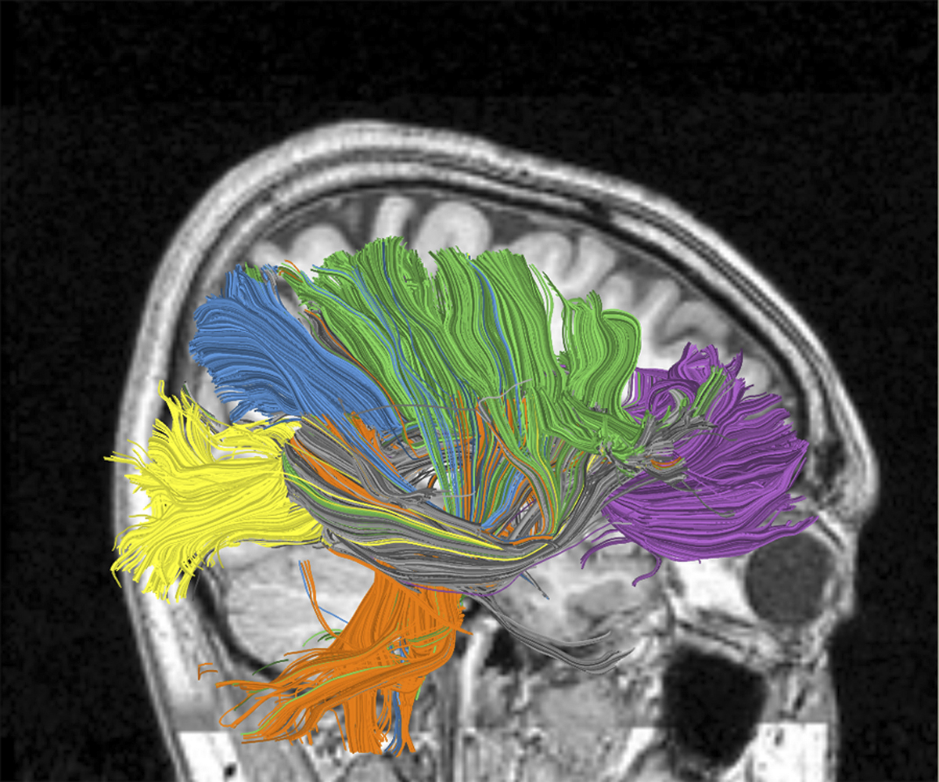
IBM Seeks to Build the Computer of the Future Based on Insights from the Brain
IBM scientists and university partners are one step closer to understanding the complex wiring system of the brain with the ultimate goal of building the computer of the future:
  one that will simulate and emulate the brain’s abilities for
  sensation,
  perception,
  action,
  interaction
  and cognition while rivaling its low power consumption and compact size.
rashid.eee.cse@gmail.com

Slide 23
DNA Computer Features
<-Present Problem->
Humans and most electronic computers must attempt to solve the problem one process at a time (linear processing).
  <-Solution->
The main benefit of using DNA computers to solve complex problems is that different possible solutions are created all at once. This is known as parallel processing.
Much lower power consumption than traditional silicon computers
Smaller compare to Silicon
Cheaper compare to Silicon
Superior processing speeds
They would use light instead of electricity to simulate zeros or ones
Heatless
rashid.eee.cse@gmail.com

Slide 24
The Future of Engineering: DNA Computers
DNA computers will be thousands of times smaller and more powerful than silicon based computers.
One pound of DNA has ability to store more data than every electronic devices ever made to date.
A water droplet sized DNA computers will have more computing power than today's most powerful supercomputers.
Another advantage of DNA computing over silicon based computers is the ability to do parallel calculations.
Silicon based microprocessors can only do on calculation at a time while DNA computer will be able to do many simultaneous calculations.
Heatless
Reference: https://www.engineergirl.org/2635/The-Future-of-Engineering-DNA-Computers
rashid.eee.cse@gmail.com

Slide 25
Microsoft Plans to Have a DNA-Based Computer by 2020 (Declared in 2017)
Microsoft even has a programming language for DNA computing that can help make DNA computing practical once the technology of bio-processors progresses to the point that it can run more sophisticated algorithms.
Scientists estimate that DNA could hold 455 exabytes of data in all. An exabyte equals a quintillion bytes or 1 billion gigabytes.
Since DNA is so densely packed, you could fit all of the world’s information on four grams (0.14 oz.) of DNA, a mere teaspoon full.
Reference- https://bigthink.com/philip-perry/microsoft-plans-to-have-a-dna-based-computer-by-2020
rashid.eee.cse@gmail.com

Slide 26
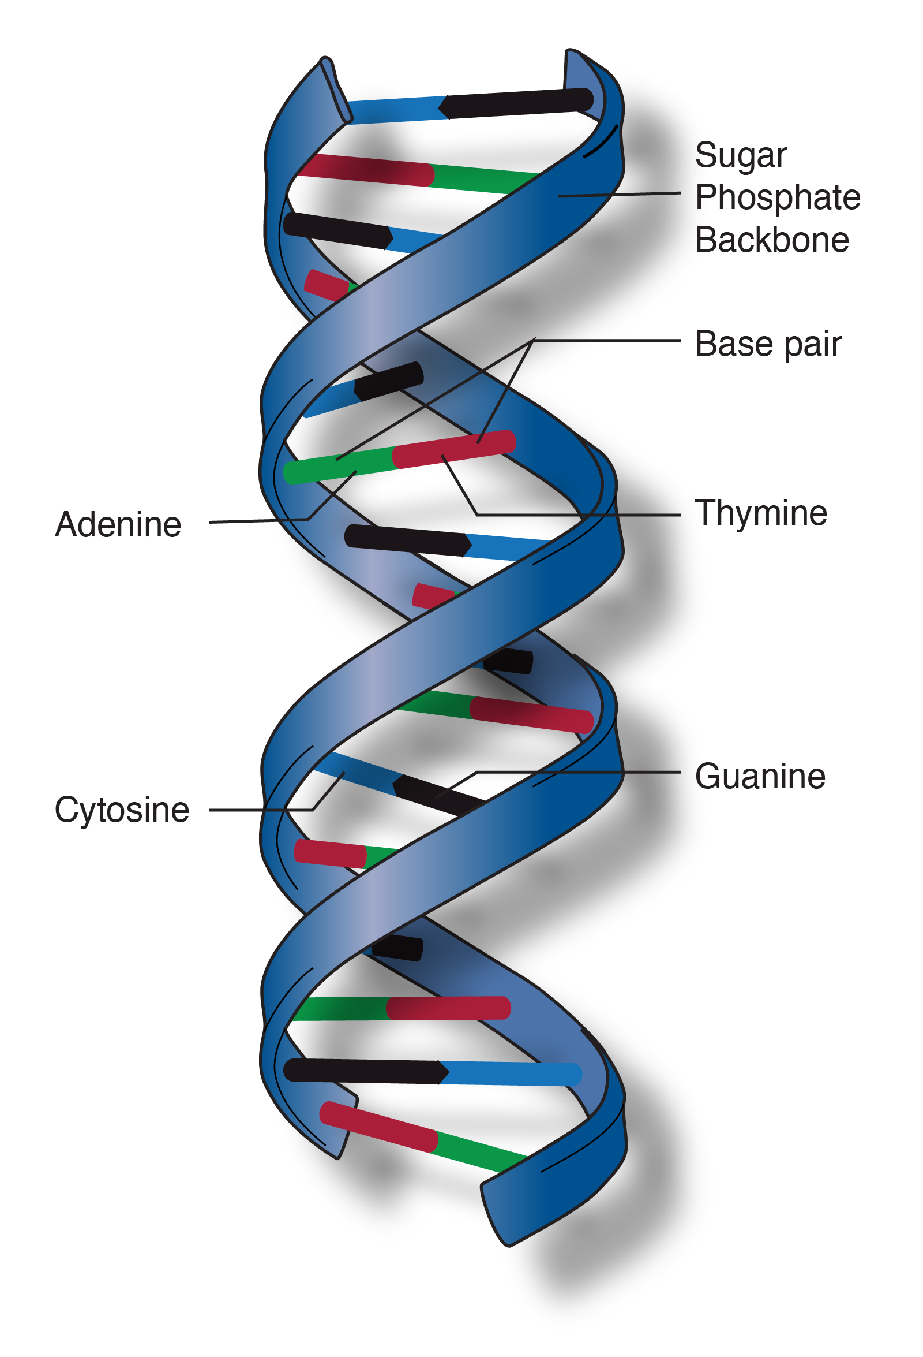
Double Helix Model
Double helix is the description of the structure of a DNA molecule. A DNA molecule consists of two strands that wind around each other like a twisted ladder. Each strand has a backbone made of alternating groups of sugar (deoxyribose) and phosphate groups. Attached to each sugar is one of four bases: adenine (A), cytosine (C), guanine (G), or thymine (T). The two strands are held together by bonds between the bases, adenine forming a base pair with thymine, and cytosine forming a base pair with guanine.
rashid.eee.cse@gmail.com

Slide 27
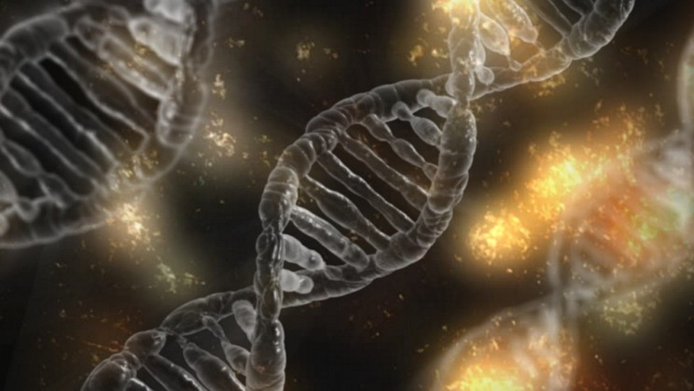
DNA Connections
rashid.eee.cse@gmail.com

Slide 28
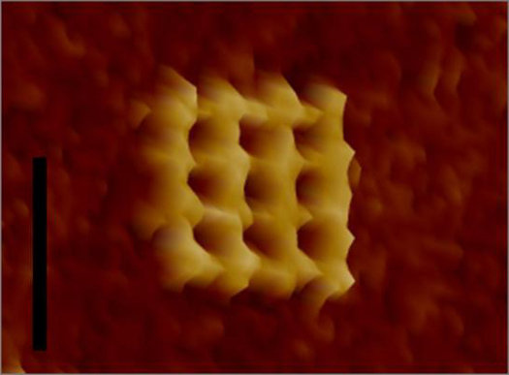
Future Computer DNA chips
rashid.eee.cse@gmail.com

Slide 29
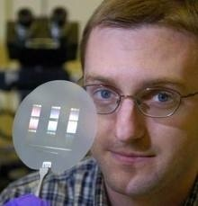
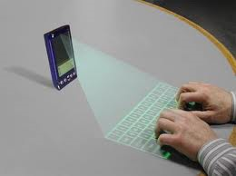
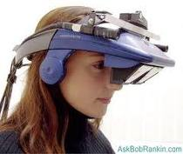
Future Computer
rashid.eee.cse@gmail.com

Slide 30
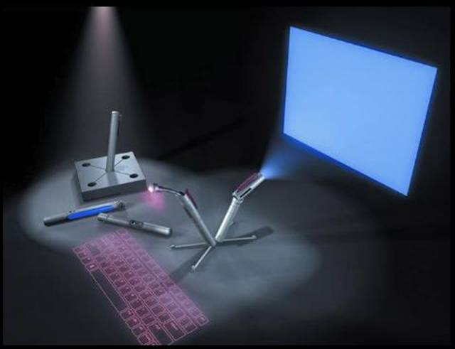
Future PC www.rense.com
rashid.eee.cse@gmail.com

Slide 31
Thank You
rashid.eee.cse@gmail.com

